Slide 1
CUSTOMER SEGMENTATION
DONE BY: VAMSHISAI PERUMANDLA

Slide 2
DEFINITION:
Customer Segmentation can be a powerful means to identify unsatisfied customer needs.
Customer segmentation is the practice of dividing a company's customers into groups that reflect similarity among customers in each group. The goal of segmenting customers is to decide how to relate to customers in each segment in order to maximize the value of each customer to the business.

Slide 3
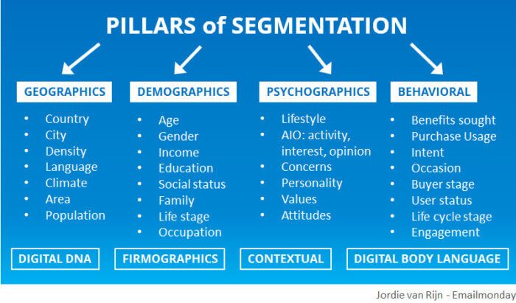
MAIN BASES/PILLARS OF SEGMENTATION:

Slide 4
MAIN BASES/PILLARS OF SEGMENTATION:
Demographic information: such as gender, age, familial and marital status, income, education, and occupation.
Geographical information: which differs depending on the scope of the company. For localized businesses, this info might pertain to specific towns or counties. For larger companies, it might mean a customer’s city, state, or even country of residence.
Psychographics: such as social class, lifestyle, and personality traits.
Behavioral data: such as spending and consumption habits, product/service usage, and desired benefits.

Slide 5
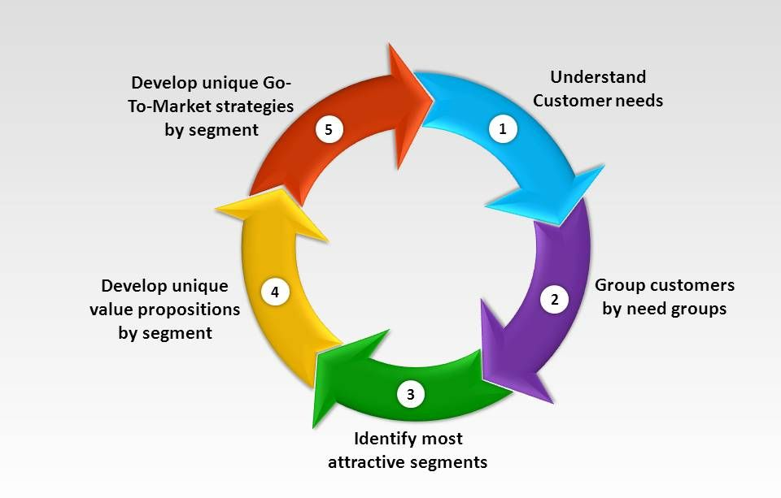
PROCESS OF CUSTOMER SEGMENTATION:

Slide 6
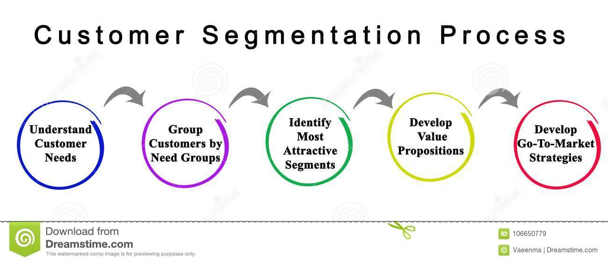
COMPONENTS OF CUSTOMER SEGMENTATION:

Slide 7
ADVANTAGES OF CUSTOMER SEGMENTATION:
Helps identify least and most profitable customers, thus helping the business to concentrate marketing activities on those most likely to buy your products or services
Helps build loyal relationships with customers by developing and offering them the products and services they want
Helps improve customer service
Helps maximize use of your resources
Helps improve or tweak products to meet customer requirements
Helps increase profit by keeping costs down

Slide 8
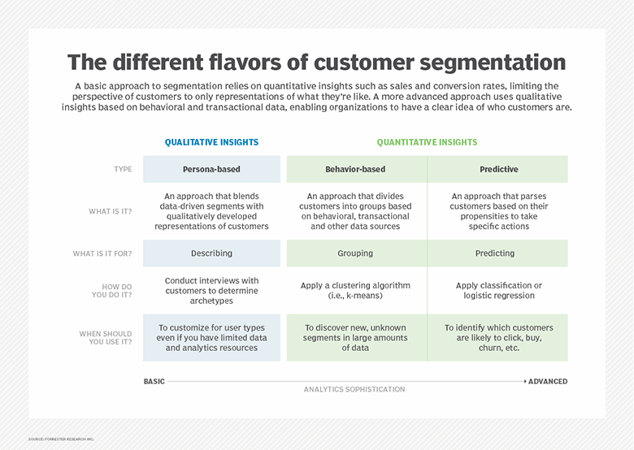
DIFFERENT FLAVOURS OF CUSTOMER SEGMENTATION:

Slide 9
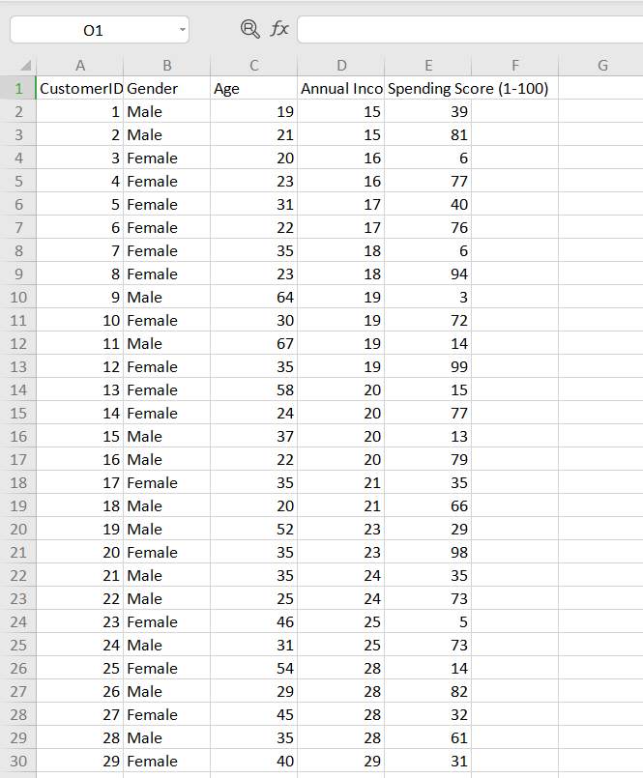
DATASET GIVEN :

Slide 10
GIVEN TASK:
Use K-means clustering and also visualize the gender and age distributions.
Analyze their annual incomes and spending scores.

Slide 11

LIBRARIES REQUIRED:
NumPy:
It is a library for the Python programming language, adding support for large, multi-dimensional arrays and matrices, along with a large collection of high-level mathematical functions to operate on these arrays.

Slide 12

LIBRARIES REQUIRED:
Pandas:
It is a software library written for the Python programming language for data manipulation and analysis. In particular, it offers data structures and operations for manipulating numerical tables and time series. It is free software released under the three-clause BSD license.

Slide 13

LIBRARIES REQUIRED:
Matplotlib:
It is a plotting library for the Python programming language and its numerical mathematics extension NumPy. It provides an object-oriented API for embedding plots into applications using general-purpose GUI toolkits like Tkinter, wxPython, Qt, or GTK.

Slide 14
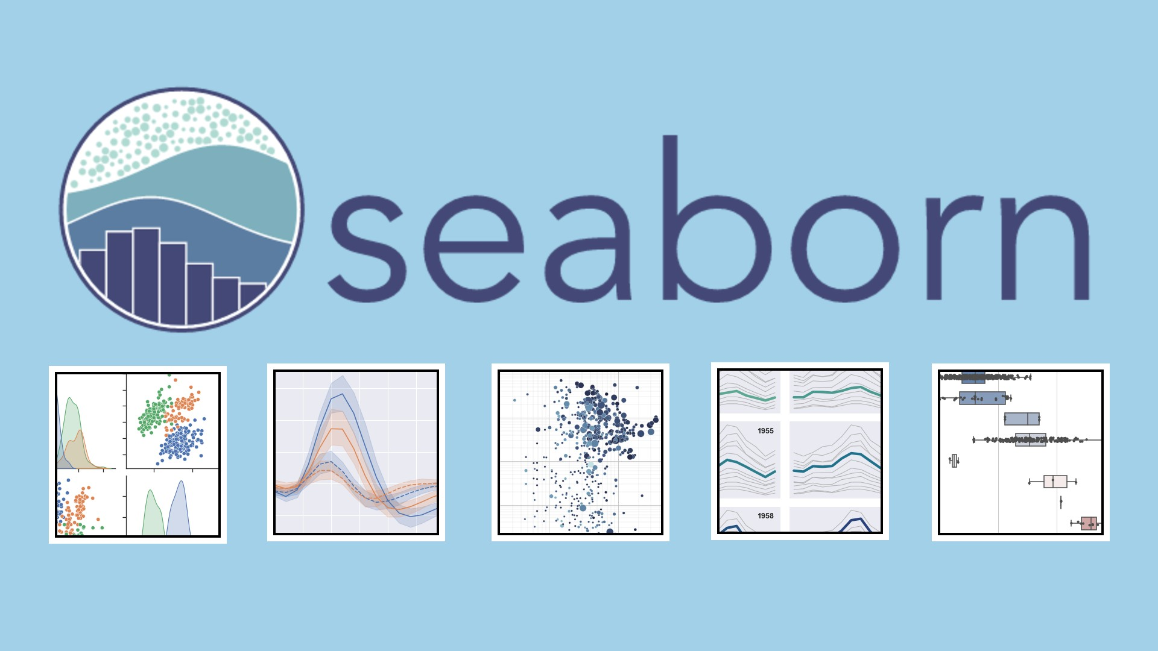
LIBRARIES REQUIRED:
Seaborn:
It is a Python data visualization library based on matplotlib. It provides a high-level interface for drawing attractive and informative statistical graphics.

Slide 15

LIBRARIES REQUIRED:
Scikit-learn
It is a free software machine learning library for the Python programming language.It features various classification, regression and clustering algorithms including support vector machines, random forests, gradient boosting, k-means and DBSCAN, and is designed to interoperate with the Python numerical and scientific libraries NumPy and SciPy.

Slide 16
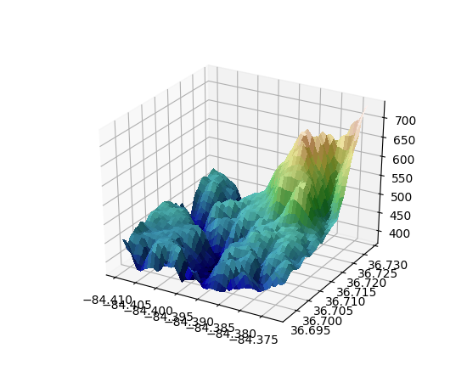
LIBRARIES REQUIRED:
mplot3d:
mpl_toolkits.mplot3d provides some basic 3D plotting (scatter, surf, line, mesh) tools. Not the fastest or most feature complete 3D library out there, but it ships with Matplotlib and thus may be a lighter weight solution for some use cases.
The plot in the right is a general example.

Slide 17
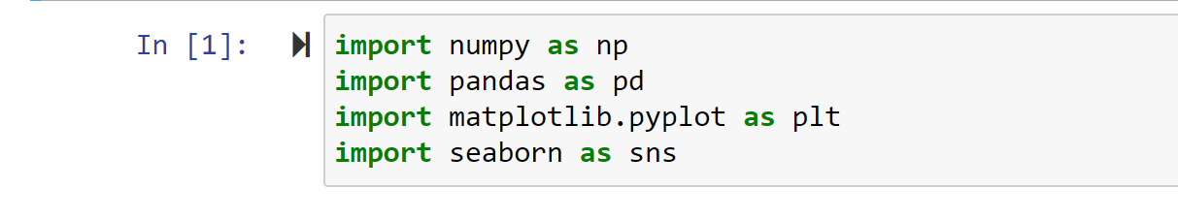
LOAD THE LIBRARIES:
Open a Jupyter notebook and import the necessary libraries/modules.

Slide 18
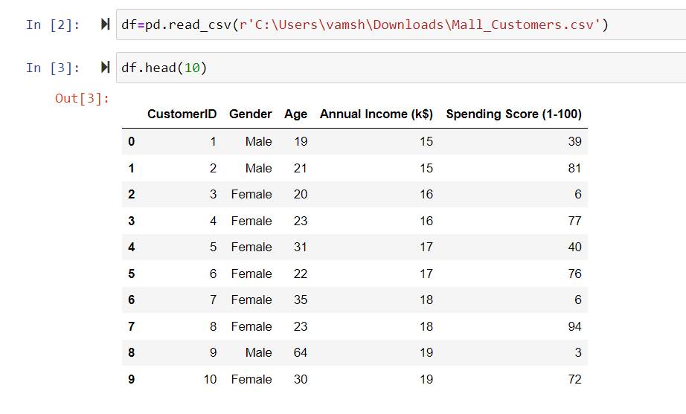
LOAD THE DATASET:

Slide 19
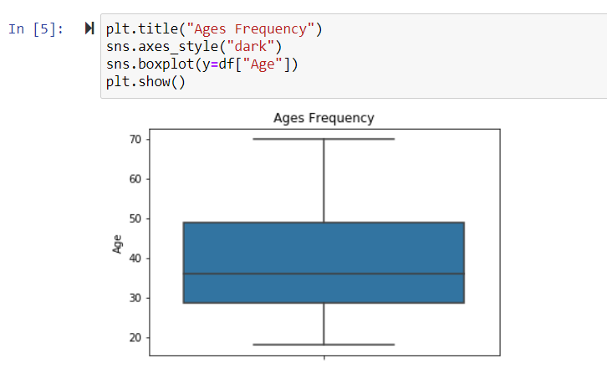
VISUALIZING AGE FREQUENCY:

Slide 20
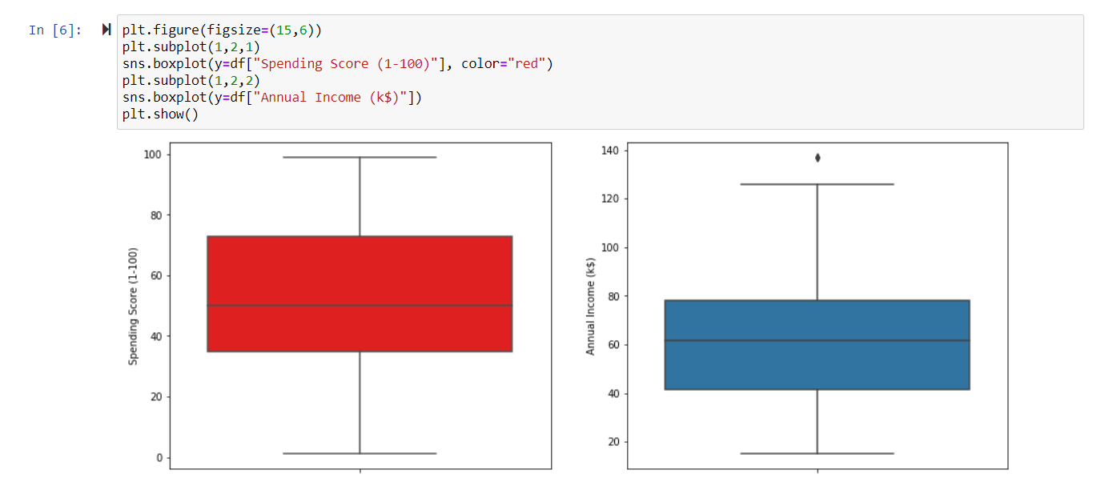
COMPARISION OF SPENDING SCORE AND ANNUAL INCOME:
Here , we find the range of spending score to be clearly more than the range of annual income

Slide 21
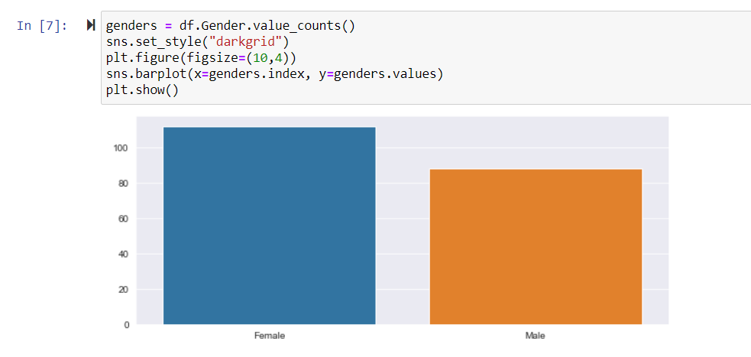
DISTRIBUTION OF POPULATION:
Here , we find the female population is more than the male population

Slide 22
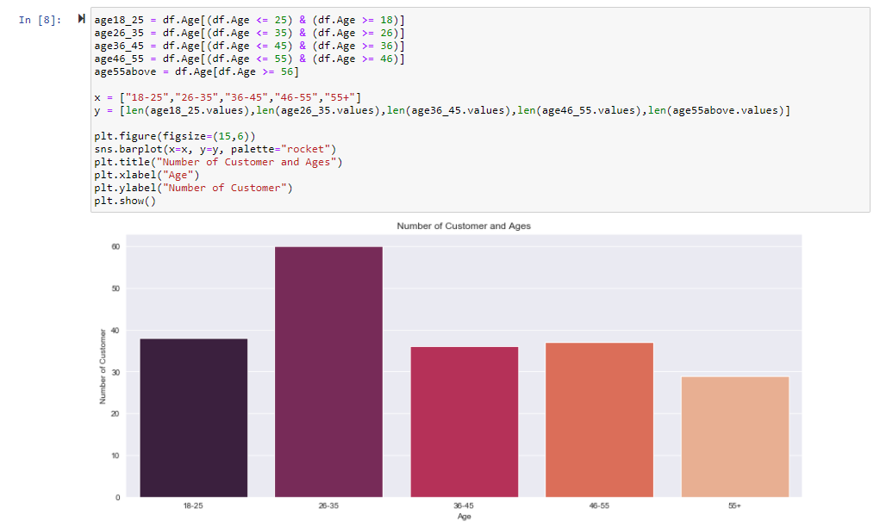
NUMBER OF CUSTOMERS IN EACH AGE GROUP:
Here , we find that the 26–35 age group outweighs every other age group.

Slide 23
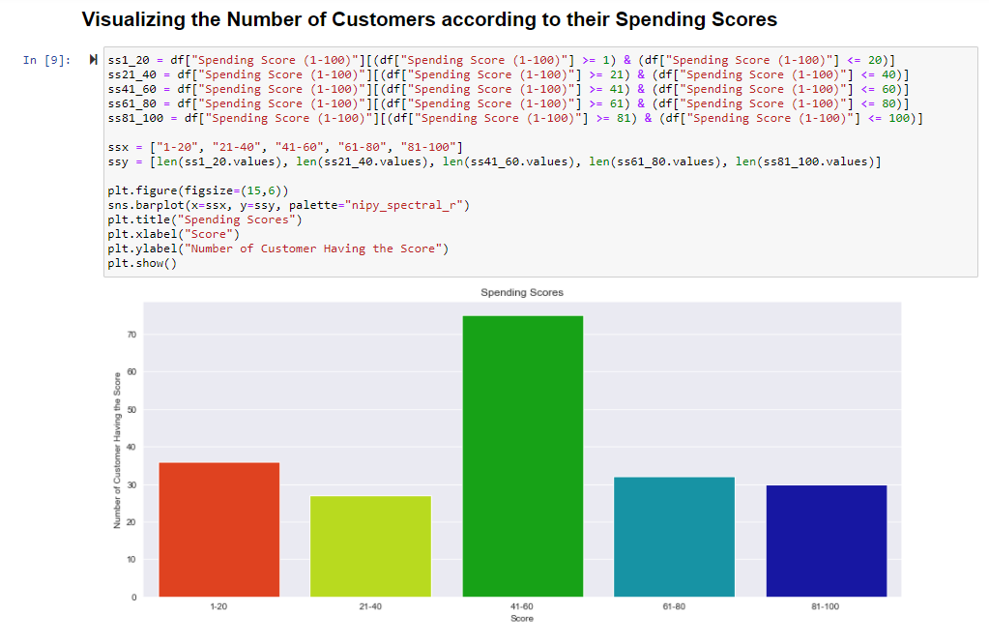
NUMBER OF CUSTOMERS ACCORDING TO SPENDING SCORES:
Here , we find that the majority of the customers have spending score in the range 41–60.

Slide 24
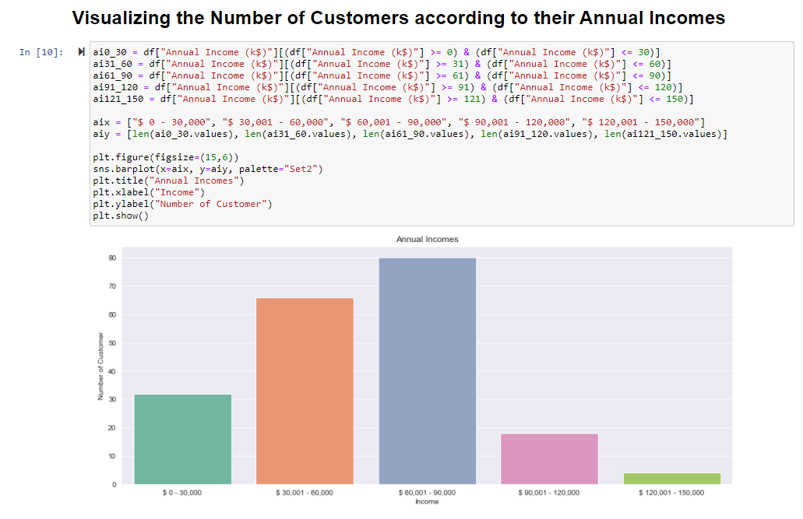
NUMBER OF CUSTOMERS ACCORDING TO ANNUAL INCOMES:
Here , we find that the majority of the customers have annual income in the range 60000 and 90000.

Slide 25

K-Means Clustering:
k-means clustering is a method of vector quantization, originally from signal processing, that aims to partition n observations into k clusters in which each observation belongs to the cluster with the nearest mean, serving as a prototype of the cluster.

Slide 26

DETERMING THE OPTIMAL VALUE OF K:
We plot the Within Cluster Sum Of Squares (WCSS) against the the number of clusters (K Value) to figure out the optimal number of clusters value. WCSS measures sum of distances of observations from their cluster centroids which is given by the below formula.
where Yi is centroid for observation Xi. The main goal is to maximize number of clusters and in limiting case each data point becomes its own cluster centroid.

Slide 27
ELBOW METHOD:
The steps can be summarized in the below steps:
Compute K-Means clustering for different values of K by varying K from 1 to 10 clusters.
For each K, calculate the total within-cluster sum of square (WCSS).
Plot the curve of WCSS vs the number of clusters K.
The location of a bend (knee) in the plot is generally considered as an indicator of the appropriate number of clusters.

Slide 28
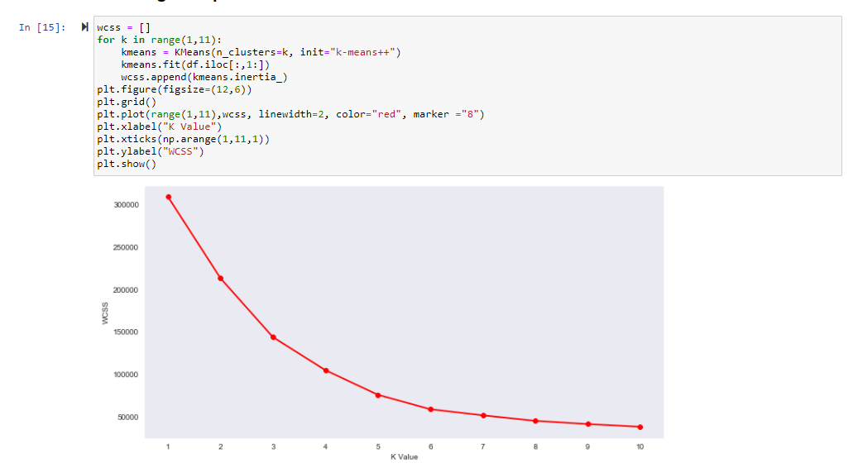
ELBOW METHOD:
Here, we find the optimal K value to be 5 according to the above plot.

Slide 29
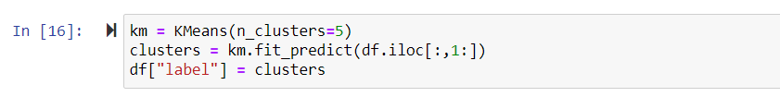
FITTING AND PREDICTION USING KMeans:
Here , we have used fit_predict() which helps us to compute cluster centers and predict cluster index for each sample and storing it in "clusters".We are creating a column called label in the dataset that will have "clusters" data so that it will be easy to identify which data corresponds to which cluster.

Slide 30
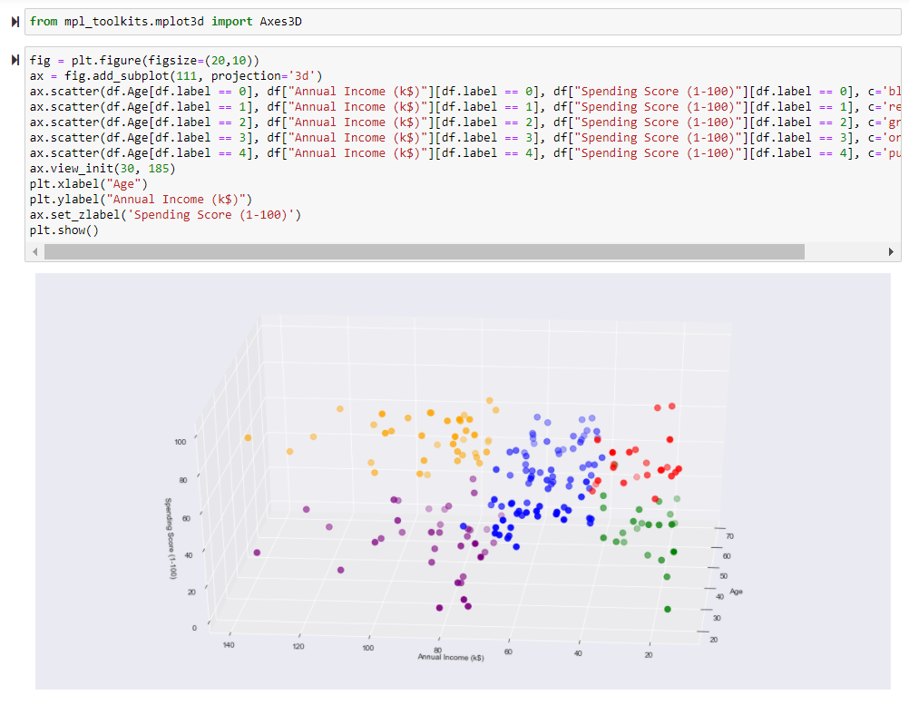
CREATING CLUSTERS:

Slide 31
CONCLUSION:
1) Here , we have made a 3D plot to visualize the spending score of the customers with their annual income.
2) Through this data and clusters we can
Determine appropriate product pricing.
Develop customized marketing campaigns.
Design an optimal distribution strategy.
Choose specific product features for deployment.
Prioritize new product development efforts.

